Slide 1

Vel Tech Rangarajan Dr. Sagunthala R&D Institute of Science and Technology
School of Computing
Department of Computer Science and Engineering
10211CS224 / FULL STACK APPLICATION DEVELOPMENT (JAVA)
PROJECT REVIEW : MILESTONE PROJECT – 2
Date: 22-04-2026
Event Hub Campus Edition
SDG: SDG No - 4 Quality Education
Presented By:
A.Praneetha – VTU24447 – 23UECS0052
Courses Handling Faculty:
Dr. S. Hemamalini, M. E, Ph.D.,
Assistant Professor (senior grade)

Slide 2
INTRODUCTION
Background :
Managing campus events manually using notices or spreadsheets is inefficient and leads to poor communication and data management. This creates difficulties in tracking event details, registrations, and updates for both students and administrators.
Need for the project :
There is a need for a centralized system to manage campus events efficiently and reduce manual work. This project helps streamline event creation, registration, and tracking, improving overall organization and user experience.
Real-World Relevance :
This system can be used in colleges and universities to efficiently manage multiple events and student registrations. It reflects real-world applications where digital platforms simplify event coordination and improve communication between users and organizers.
System Overview :
The system is a web-based application where students can view and register for campus events, while administrators can create, update, and manage event details. It uses Spring Boot, JPA, and Thymeleaf to provide a structured and user-friendly event management platform.
1
2
3
4
5
6
7
8
9

Slide 3
PROBLEM STATEMENT
In many educational institutions, campus event management is still handled through manual or semi-digital methods, leading to inefficiencies and lack of coordination. Event information is often fragmented, making it difficult for students to stay informed and participate effectively.
Administrators face challenges in managing registrations, updating event details, and maintaining accurate records. The absence of a centralized system results in poor communication and limited scalability.
These limitations affect the overall efficiency and organization of campus activities. Therefore, there is a strong need for a structured, reliable, and automated solution to streamline event management and enhance user experience.
1
2
3
4
5
6
7
8
9

Slide 4
OBJECTIVE(S)
1
To design and develop a web-based campus event management system.
To implement a centralized platform for event creation, registration, and management.
To improve communication and accessibility of event information for students.
To enhance data management and reduce manual effort in handling campus events.
2
3
4
5
6
7
8
9

Slide 5
PROPOSED SYSTEM
The proposed system is a web-based application designed to manage campus events efficiently.
It provides a centralized platform for students and administrators to interact.
Students can view upcoming events, register online, and track their participation.
Administrators can create, update, and delete event details through a secure interface.
The system automates event management, reducing manual effort and errors.
It ensures real-time updates and easy access to event information.
Data is stored and managed securely using a database system.
Overall, it improves efficiency, organization, and user experience compared to traditional methods.
1
2
3
4
5
6
7
8
9

Slide 6
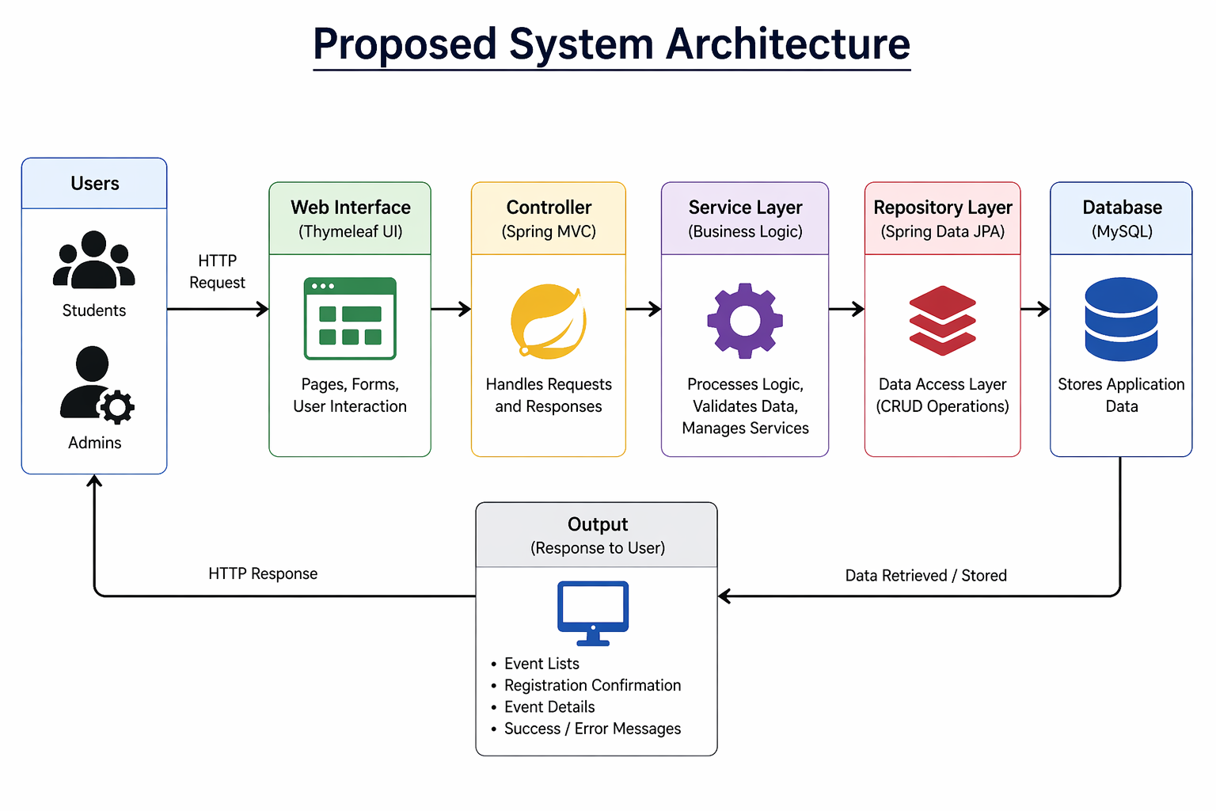
PROPOSED SYSTEM ARCHITECTURE
Input
Users (students/admins) interact through web pages.
Input includes event details, registration forms, login data
Processing
Controller receives user requests.
Service layer processes business logic.
Example: validating data, handling registrations.
Database
Data is stored in MySQL database.
Tables like:
Event
Registration
Managed using Spring Data JPA.
Output
Processed data is displayed using Thymeleaf pages.
Users can see:
Event list.
Registration confirmation.
Updated event details.
1
2
3
4
5
6
7
8
9

Slide 7
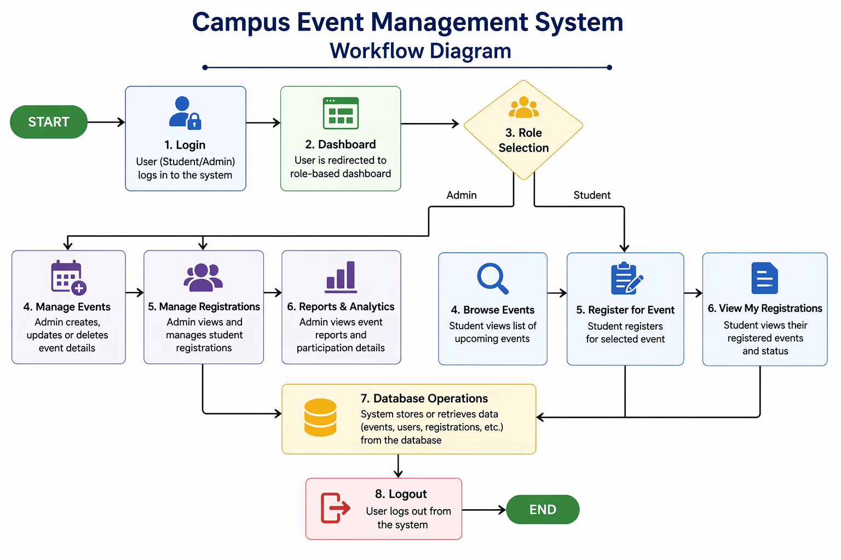
WORKFLOW
1
2
3
4
5
6
7
8
9

Slide 8
TECHNOLOGIES USED
1
Frontend: HTML5, CSS3, Thymeleaf, JavaScript
Backend: Java, Spring Boot, Spring MVC, Spring Data JPA
Database: MySQL
Tools: VS Code / Eclipse, Maven, Postman, Git
Hardware/Software Requirements:
4GB RAM (minimum)
Dual-core processor
Java JDK 17+
MySQL Server
Web Browser (Chrome/Edge)
2
3
4
5
6
7
8
9

Slide 9
MODULE DESCRIPTION
Module 1: User Management
Handles student and admin login with authentication and role-based access control.
Module 2: Event Management
Allows admin to create, update, delete, and manage campus events efficiently.
Module 3: Registration Management
Enables students to register for events and view their registration details.
Module 4: Data Management & Reporting
Manages event and registration data, and provides basic statistics and reports.
1
2
3
4
5
6
7
8
9

Slide 10
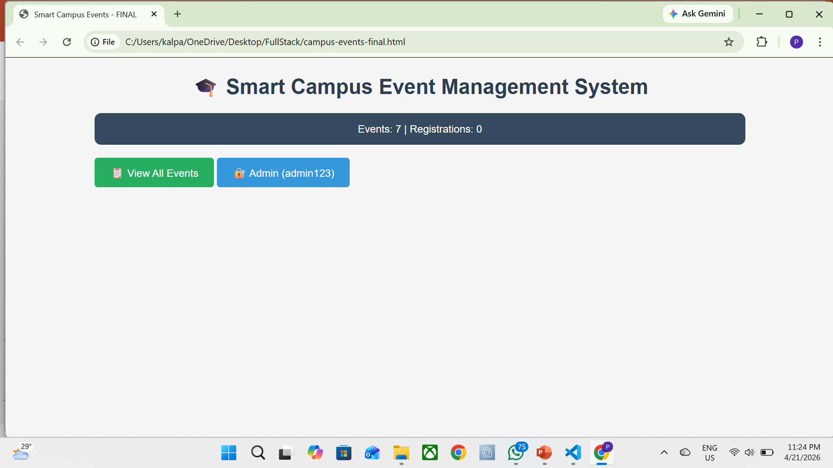
IMPLEMENTATION SCREENSHOTS
1
2
3
4
5
6
7
8
9

Slide 11
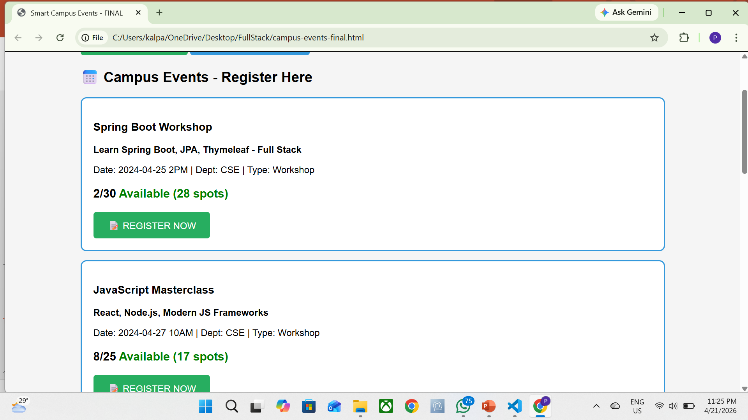
IMPLEMENTATION SCREENSHOTS
1
2
3
4
5
6
7
8(A)
9

Slide 12
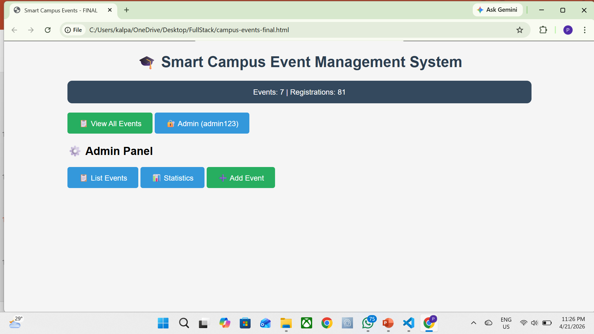
IMPLEMENTATION SCREENSHOTS
1
2
3
4
5
6
7
8(B)
9

Slide 13
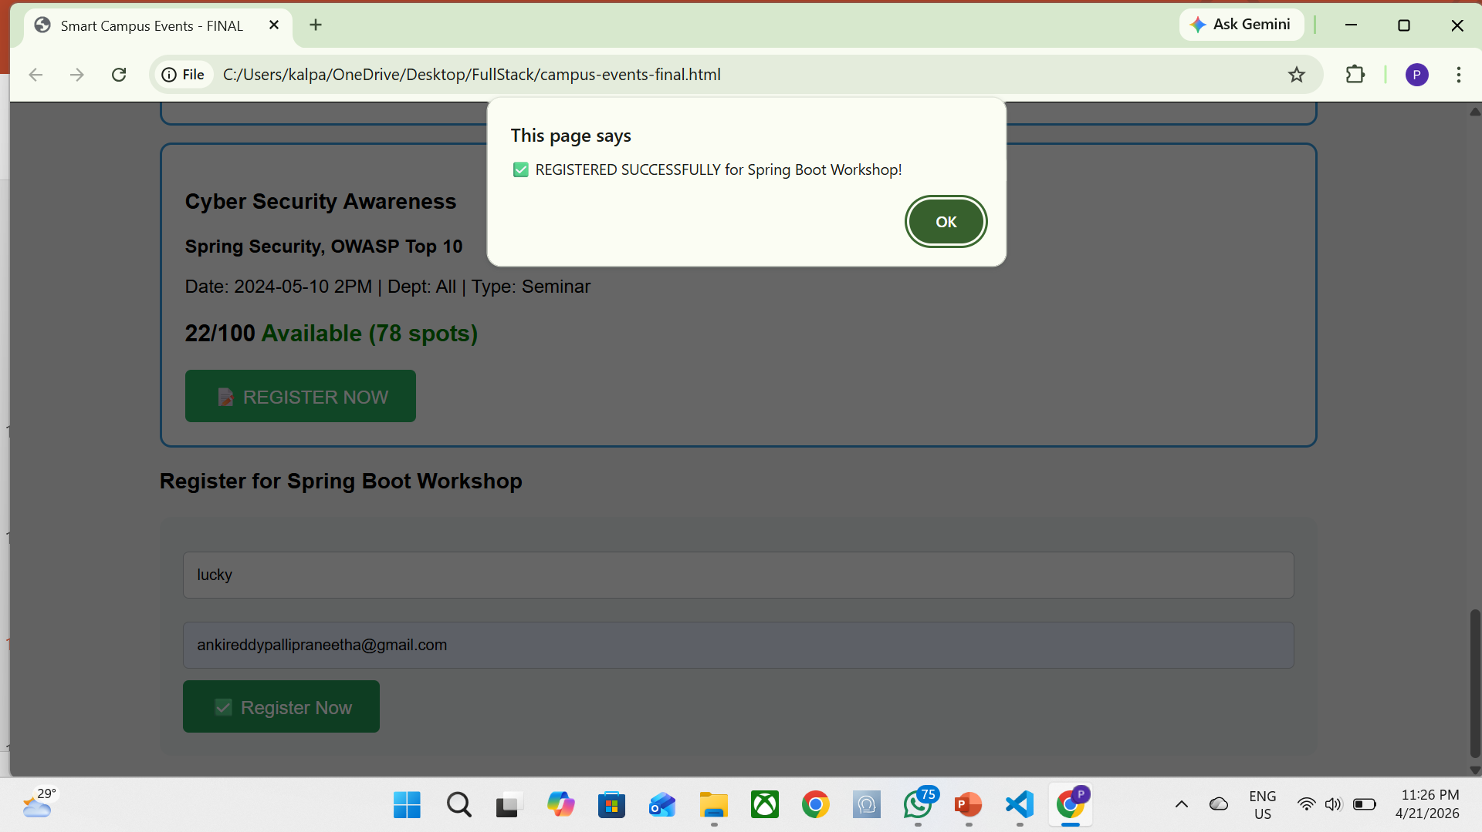
IMPLEMENTATION SCREENSHOTS
1
2
3
4
5
6
7
8(C)
9

Slide 14
ADVANTAGES & LIMITATIONS
1
Advantages :
Provides a centralized platform for managing all campus events efficiently.
Reduces manual work and minimizes errors in event handling.
Enables easy event registration and access for students.
Improves communication between administrators and students.
Ensures better data management and real-time update.
Limitations :
Requires internet connection for access and functionality.
Basic security implementation (can be improved for real-world deployment).
Limited scalability for very large institutions or heavy traffic.
Depends on proper database configuration and maintenance.
UI/UX may be simple and can be enhanced further.
2
3
4
5
6
7
8
9

Slide 15
Thank you

